Slide 1
2D Cell Image Segmentation
low-constrast cell clusters (c1)
high-constrast cell nuclei (c3)

Slide 2
Experiments
Thresholding: Otsu’s method
Contrast Enhancement:
histogram equalization
inverse Gaussian gradient
Denoising: Gaussian, morph operations
Edge: Canny, contour
Segmentation:
Watershed (morph operations)
Snakes
Chan-vese
MorphGAC
MorphACWE

Slide 3
Thresholding
Denoising
Watershed
Building Markers
Watershed
C3
C1

Slide 4
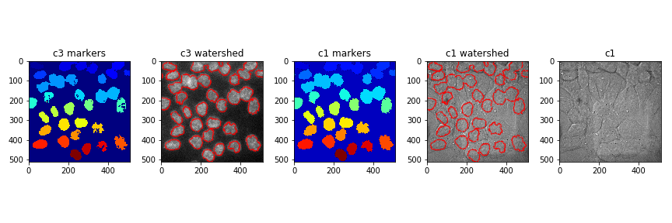
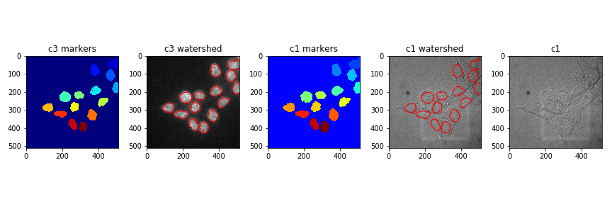
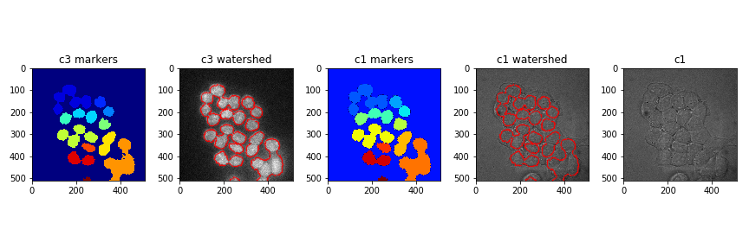

Slide 5
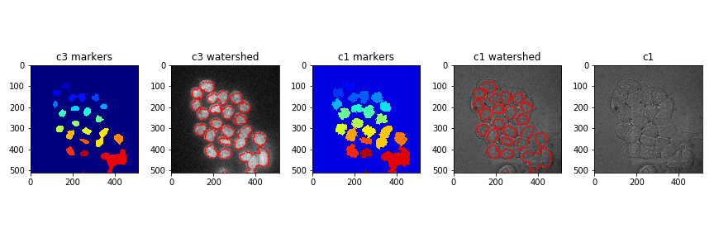
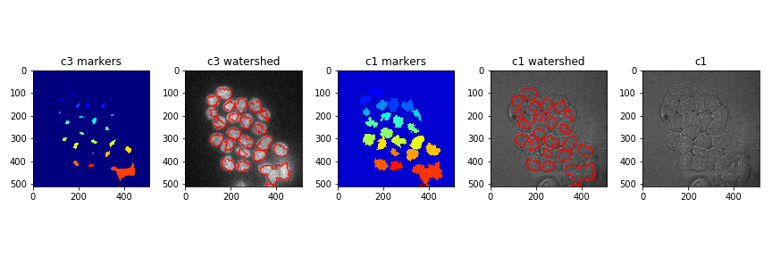
Threshold=0.1
Threshold=0.3
Threshold=0.5

Slide 6
Thresholding
Denoising
Watershed
Building Markers
Watershed
MorphGAC
C3
C1

Slide 7




Slide 8
Threshold=0.1
Threshold=0.3
Threshold=0.5

Slide 9
Thresholding
Denoising
Watershed
Building Markers
Watershed
MorphGAC
MorphGAC
C3
C1

Slide 10


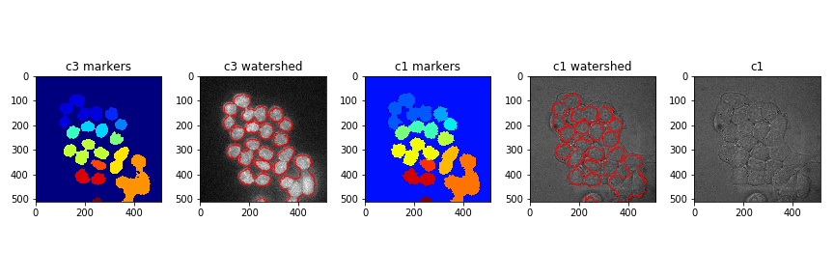

Slide 11
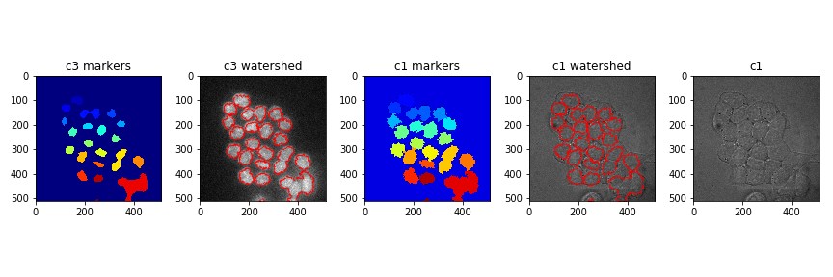
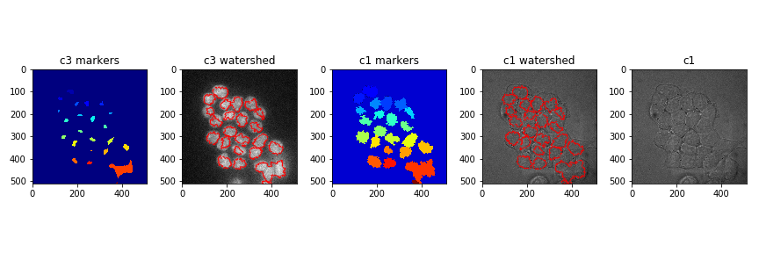
Threshold=0.1
Threshold=0.3
Threshold=0.5

